Slide 1

MACHINE LEARNING PROJECT – CRN 31143 Project: Machine Learning with Natural disaster implementation on crop cultivation in the agricultural process

Slide 2

Group Member Information:
Akunuri Sri Priya (700744712)
Sanath Kumar Ankala (700744158)
Pravalika Medasani (700744503)

Slide 3

Role/Responsibilities and Contribution in project:
1. Sanath Kumar Ankala – 700744158
Project preliminary research and design
Project flow design
2. Pravalika Medasani – 700744503
Machine learning algorithm selection and implementation
Data analysis and visualization
3. Akunuri Sri Priya – 700744712
Model assessment and refinement
Documentation and final report

Slide 4

Motivation:
For detecting natural disasters in agricultural production.
Early identification of floods, droughts, cyclones, and earthquakes to mitigate their impact on crops.
Helpful to take necessary actions in correct time for the cultivation.

Slide 5

Objectives:
To study agricultural cultivation affected by recurring seasonal catastrophes.
To study the effects of occasional disasters.
Examine the relevant qualities employed in prediction analysis, including earthquakes, floods, droughts, cyclones, tsunamis, landslides, and avalanches.
Conduct data analysis considering weather conditions, temperature, soil type, nutrient content, and regional rainfall to determine the optimal crop selection for planting.

Slide 6
Related work:
Significance:
The application will be developed with Google Colab Python Tool.
The algorithm libraries are built inside the Colab.
It helps the project to use the algorithm in the finding of natural disaster with crop cultivation.
Techniques Applied:
The task included examination of the natural disaster with crop cultivation dataset using appropriate information handling.
The machine learning library and Machine learning libraries Sklearn are applied into the application.

Slide 7

Problem Statement:
Analyze the various related attributes like earthquakes, floods, droughts, cyclones, tsunamis, landslips and avalanches prediction analysis along with the weather and temperature, type of soil, nutrient value of the soil in that region, amount of rainfall in the region, soil composition and give proper recommendations about required fertilizer ratio based on atmospheric and soil parameters of the land which enhance to increase the crop yield and increase farmer revenue.

Slide 8
Proposed Solution:
In this work, the dataset containing the crop disaster dataset will be taken into consideration. The pre-processing will be applied in to the dataset and the noisy and null value data will be removed from the dataset.
After the data will be analyzed and visualized for further processing. The machine learning algorithm will be applied to make the analysis.
The project evaluation can be tested with the Machine learning algorithm prediction results.
Since the Machine learning algorithm will be used to predict the disease, the accuracy of the algorithm result will be helpful to evaluate the results.
The accuracy score of the algorithm in the natural disaster with crop cultivation helps to evaluate the dataset.

Slide 9
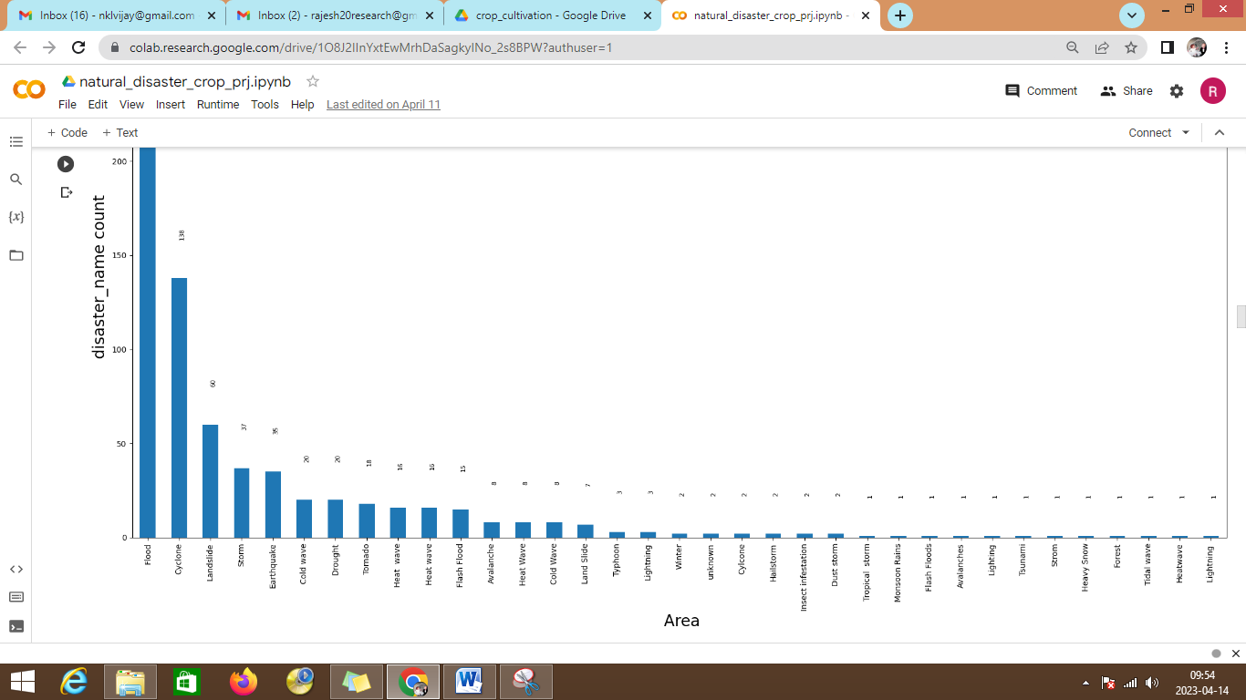
Results/Simulations:
The results show the total number of disaster types and the name of the disaster with effect to the area

Slide 10
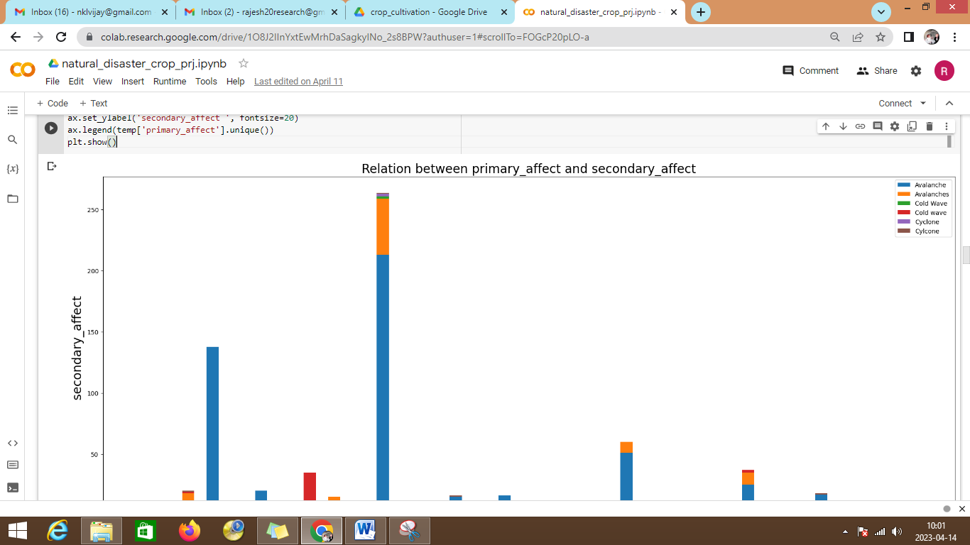
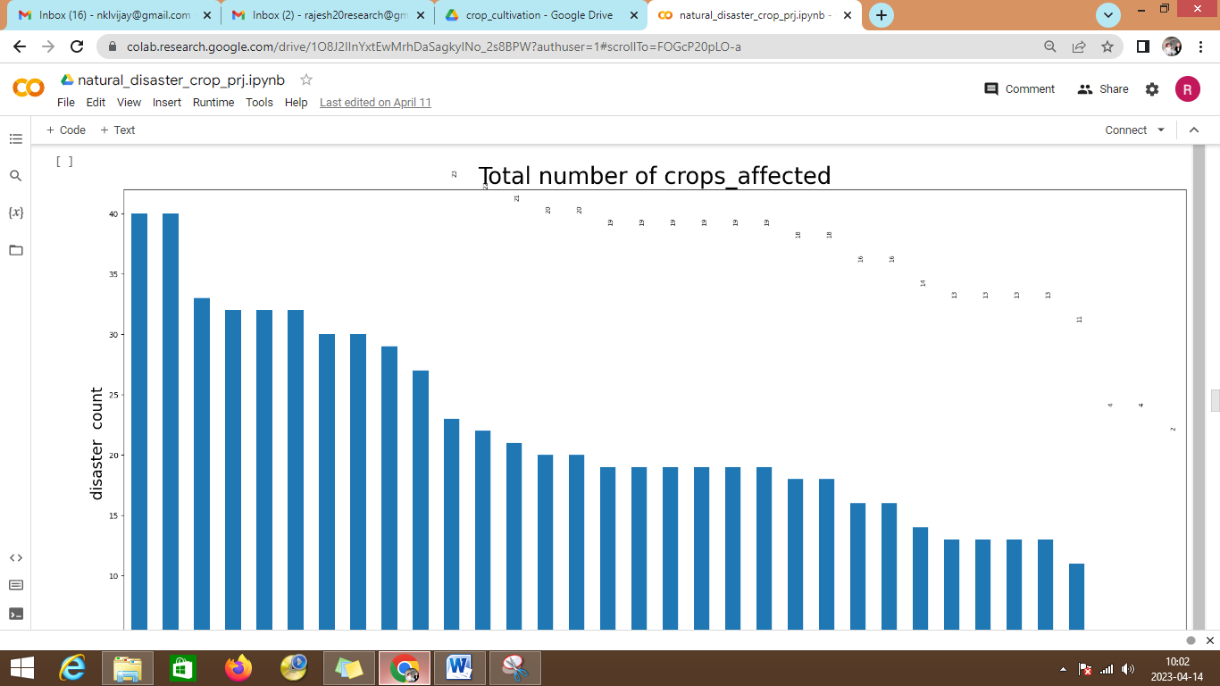
The implementation shows the primary affect with the secondary affect after the execution of machine learning algorithm.
The graph displays the total number of crops affected due to the disaster taken in the different type of states

Slide 11
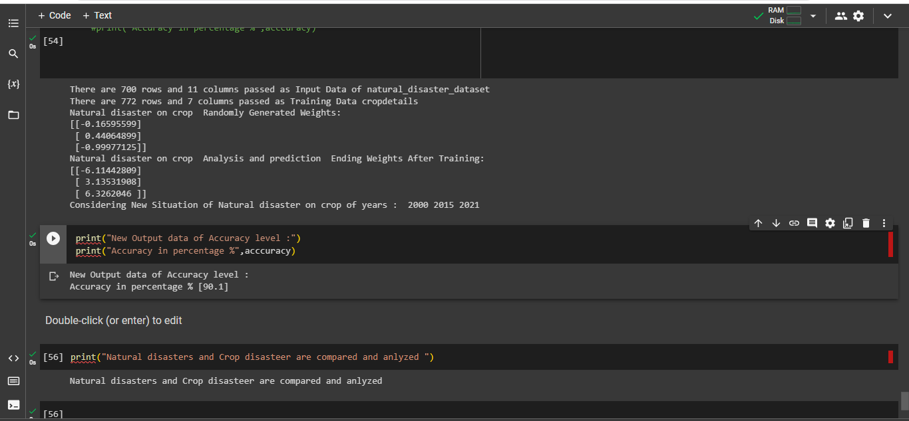
Test Accuracy Percentage is 90.1%

Slide 12

References:
[1] Md Shah Jalal Jamil;Afra Anika;Md. Saddam Hossain Mukta;Mohammad Nurul Huda,"Ensemble of Classifiers Based Soil Evaluation for Crop Cultivation”, 2022 IEEE Region 10 Symposium .
[2] Sabbir Ahmed;Shamima Yesmin; Lata Rani Saha; A. K. M. Sadat;Mozammel H A Khan“Major Cropping Pattern Prediction in Bangladesh from Land, Soil and Climate Data Using Machine Learning Techniques”, 2022, 25th International Conference on Computer and Information Technology (ICCIT).
[3] Swati Vashisht;Praveen Kumar;Munesh Chandra Trivedi“, Improvised Extreme Learning Machine for Crop Yield Prediction”2022- 3rd International Conference on Intelligent Engineering and Management (ICIEM).
[4] M. S. J. Jamil, A. K. M. M. Islam, B. Ahamed and M. N. Huda, "Iprocad: Intelligent prognosis of coronary artery disease excluding angiogram in patient with stable angina", International Journal of Innovative Technology and Exploring Engineering, vol. 9, no. 5, pp. 2032-2040, 2020.
[5] Agriculture Extension Office, (2010): Kalapara, Patuakhali, Bangladesh. Ahmed, M. & Suphachalasai, S, (2009): "Assessing the Costs of Climate Change and Adaptation in South Asia".

